Slide 1



Bi-Weekly Update 3
Team 32: Abhi Singh, Holden Haile, Kelton Chesshire Sponsor: Eric Lloyd Robles TA: Eric Lloyd Robles
Notes:
Michelle

Slide 2
Problem Statement
In the U.S. Alone over 10% of the population suffers from Diabetes. Type 1 diabetes can require a person to monitor their blood sugar level 4-10 times a day and intake carbohydrates if their blood sugar is low. This can become a guess and check game where the person is not able to consistently and accurately dose themselves, and can lead to detrimental effects on quality of life.

Slide 3
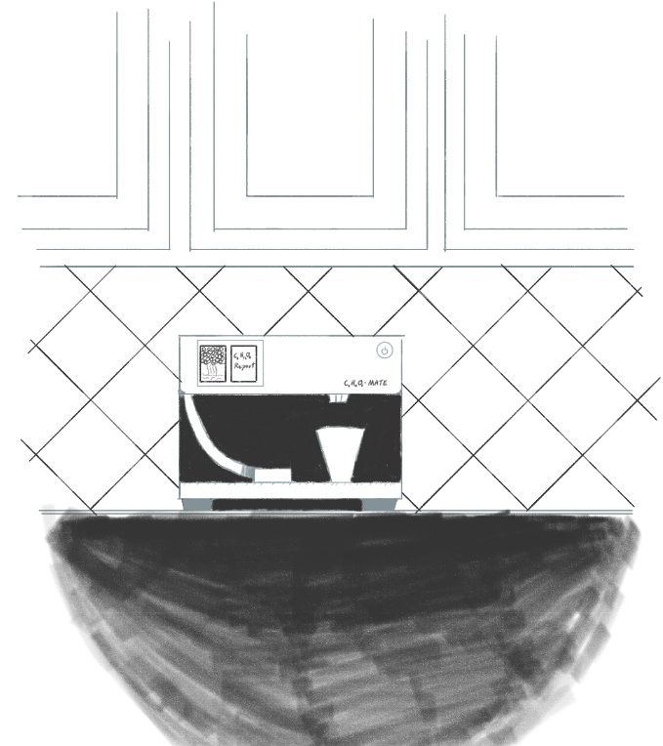
Solution Proposal
Our system will dispense carbohydrates in a consistent, accurate, and easily-consumable manner so that users have an easy way of maintaining a normal blood sugar level 24/7.

Slide 4
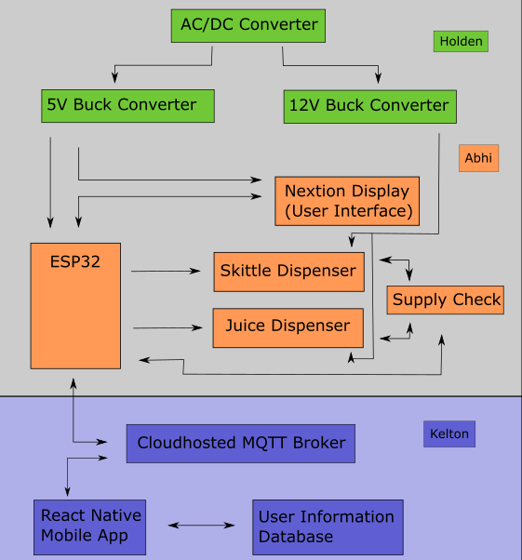
System Overview
Power Supply
Dispenser
Application

Slide 5
Subsystem Changes/Improvements since last week
Design Changes proposed to us by Dr. John Lusher and Subsystem Improvements that are being actively implemented
Dispenser: Tested Sensors, Planned Circuit Layout, Measured Dimensions for the enclosure CAD model
Power Supply: Completed system validation and verified all values in and out of the circuit
Application: Further Notification / Background Task Testing
Notes:
Eric

Slide 6
Project Timeline
Last Week
Next 2 weeks
10/5
11/5
11/16
Discuss System Improvements
Subsystem Improvements
Major Project Design
Final Subsystem Integration
Preparation for Final Presentation & Demo
We focused on how to improve our subsystems from the good baseline from 403
Subsystem Improvements will be made and tested
Design Housing and PCBs for Power Supply and Dispenser, App integration with Health Apps, HMI control implemented
Dispenser and Power Supply will be installed in the housing, testing and validation of System: Dispenser powered with our Power Supply and Tested with Our App
Final Tweaks to subsystems if needed, polishing the product for presentation and testing user experience
Notes:
Eric

Slide 7
Power Supply
Holden Haile
Accomplishments since last presentation 8 hrs of effort | Ongoing progress/problems and plans until the next presentation
Validation finalized Began crash course on CAD modeling to begin enclosure design | Housing Design process Complete integration of microcontroller and power supply system

Slide 8
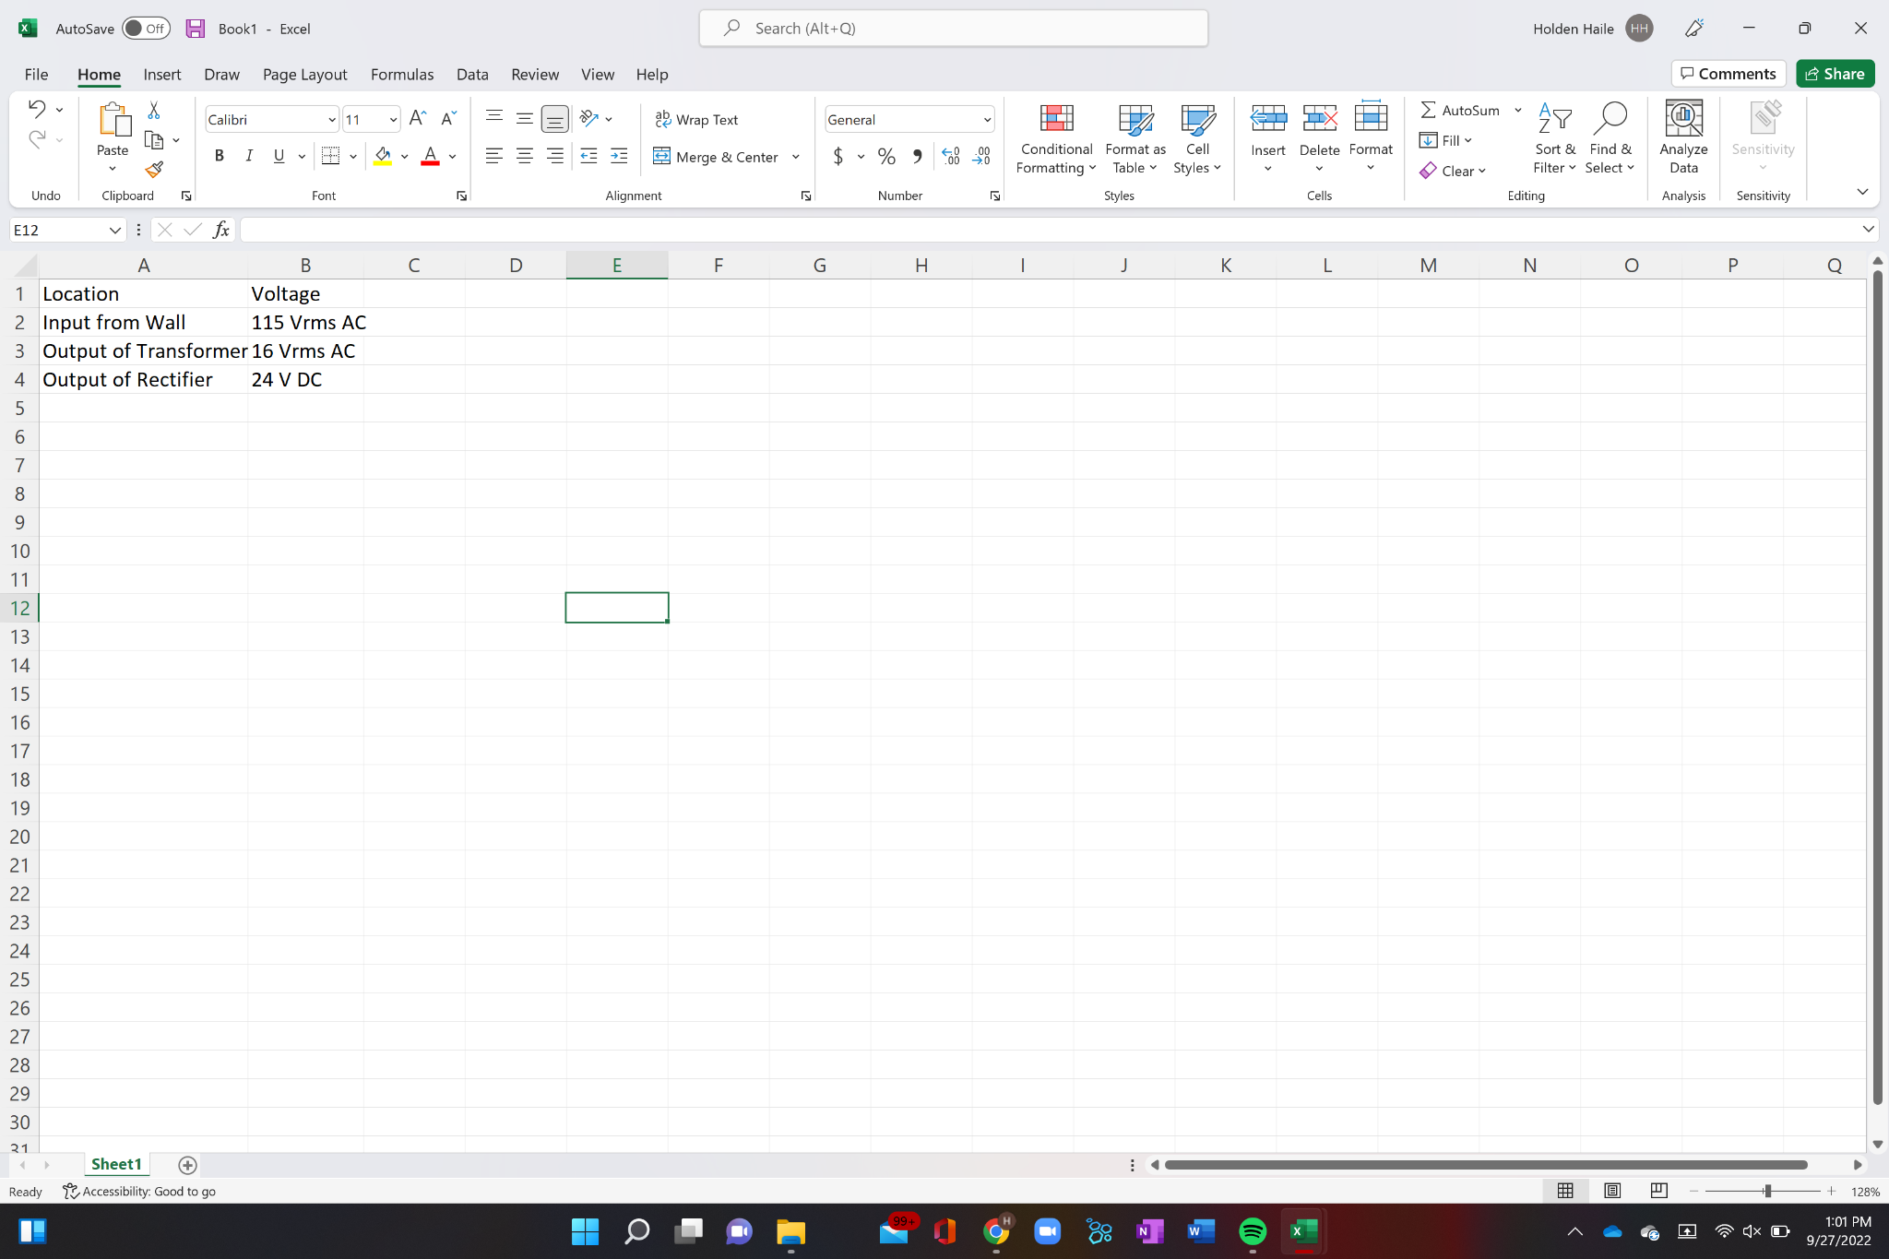
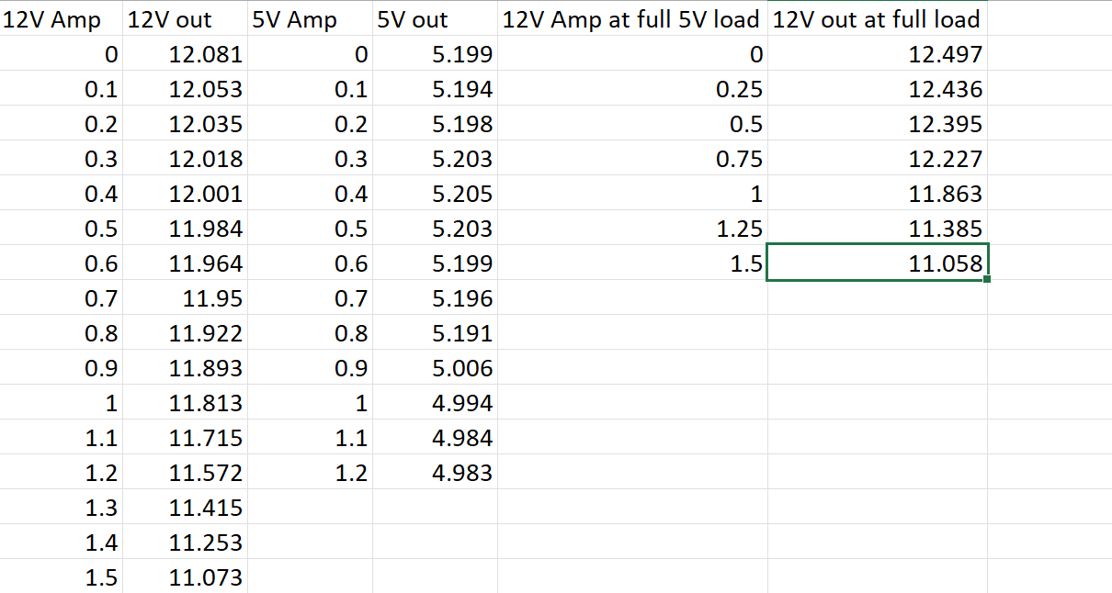
Power Supply
Holden Haile
Power supply Validated and prepared for integration
Housing design process started and will be worked on in the next two weeks

Slide 9
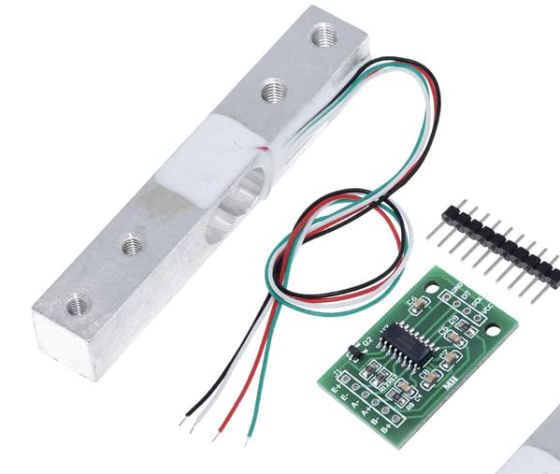
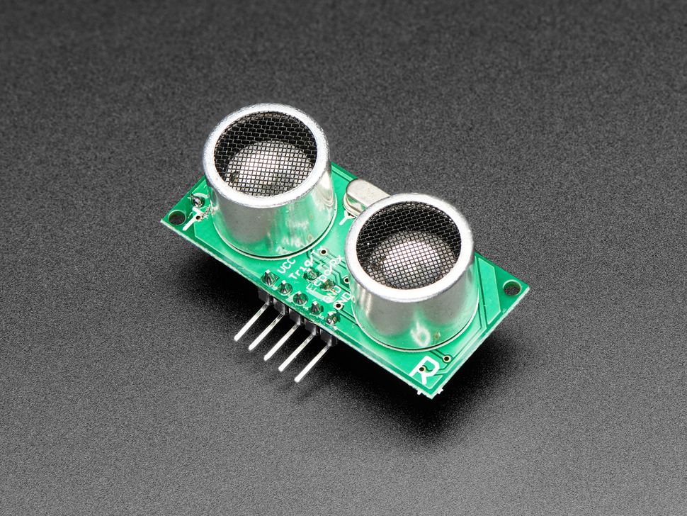
Dispenser
Abhi Singh
Accomplishments since Last Update 6 hrs | Ongoing progress/problems and plans until the next presentation
Designed an updated dispenser that incorporates the pressure sensor cell and improves the design to get rid of skittle jams | Design the lid for the Juice volume measurer (ultrasonic sensor 3D print both designs and begin validation Design Nextion Display pages for User Interface and test with ESP32

Slide 10
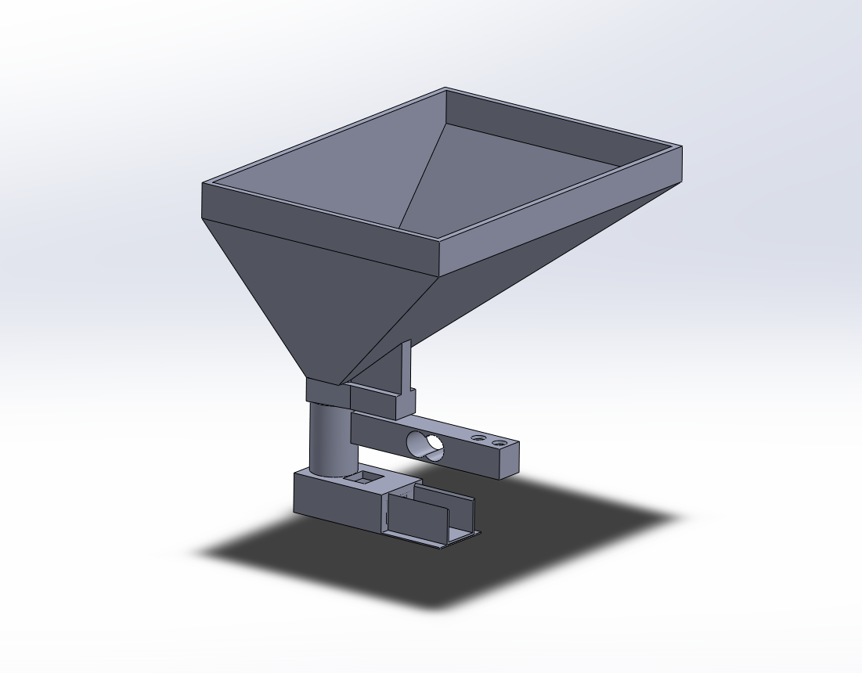
Dispenser
Abhi Singh
Updated dispenser now uses a Pressure Load Cell to measure current amount of Skittles
Next Step:
design the enclosure that will house the dispenser and the juice canister
design the lid that will read the amount of juice in the canister

Slide 11
Application
Kelton Chesshire
Accomplishments since Last Update 12 hrs of effort | Ongoing progress/problems and plans until the next presentation
Notification Testing Background Task Testing | Further Notification & Background Task Testing More Information Screens

Slide 12
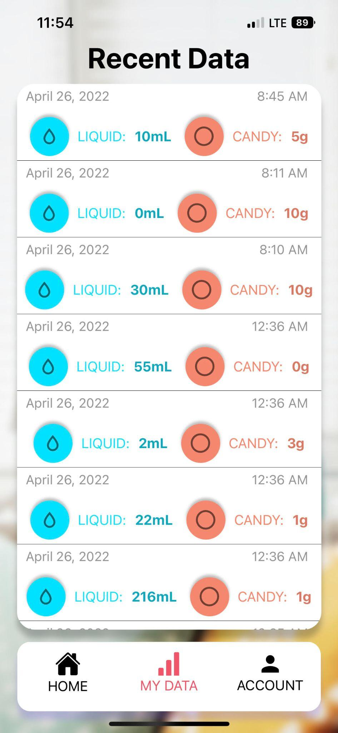
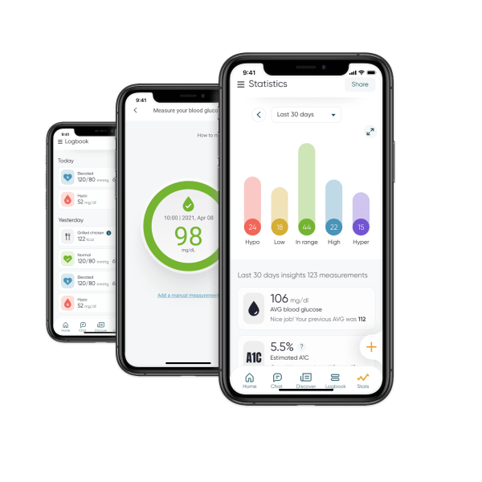
Application
Kelton Chesshire

Slide 13
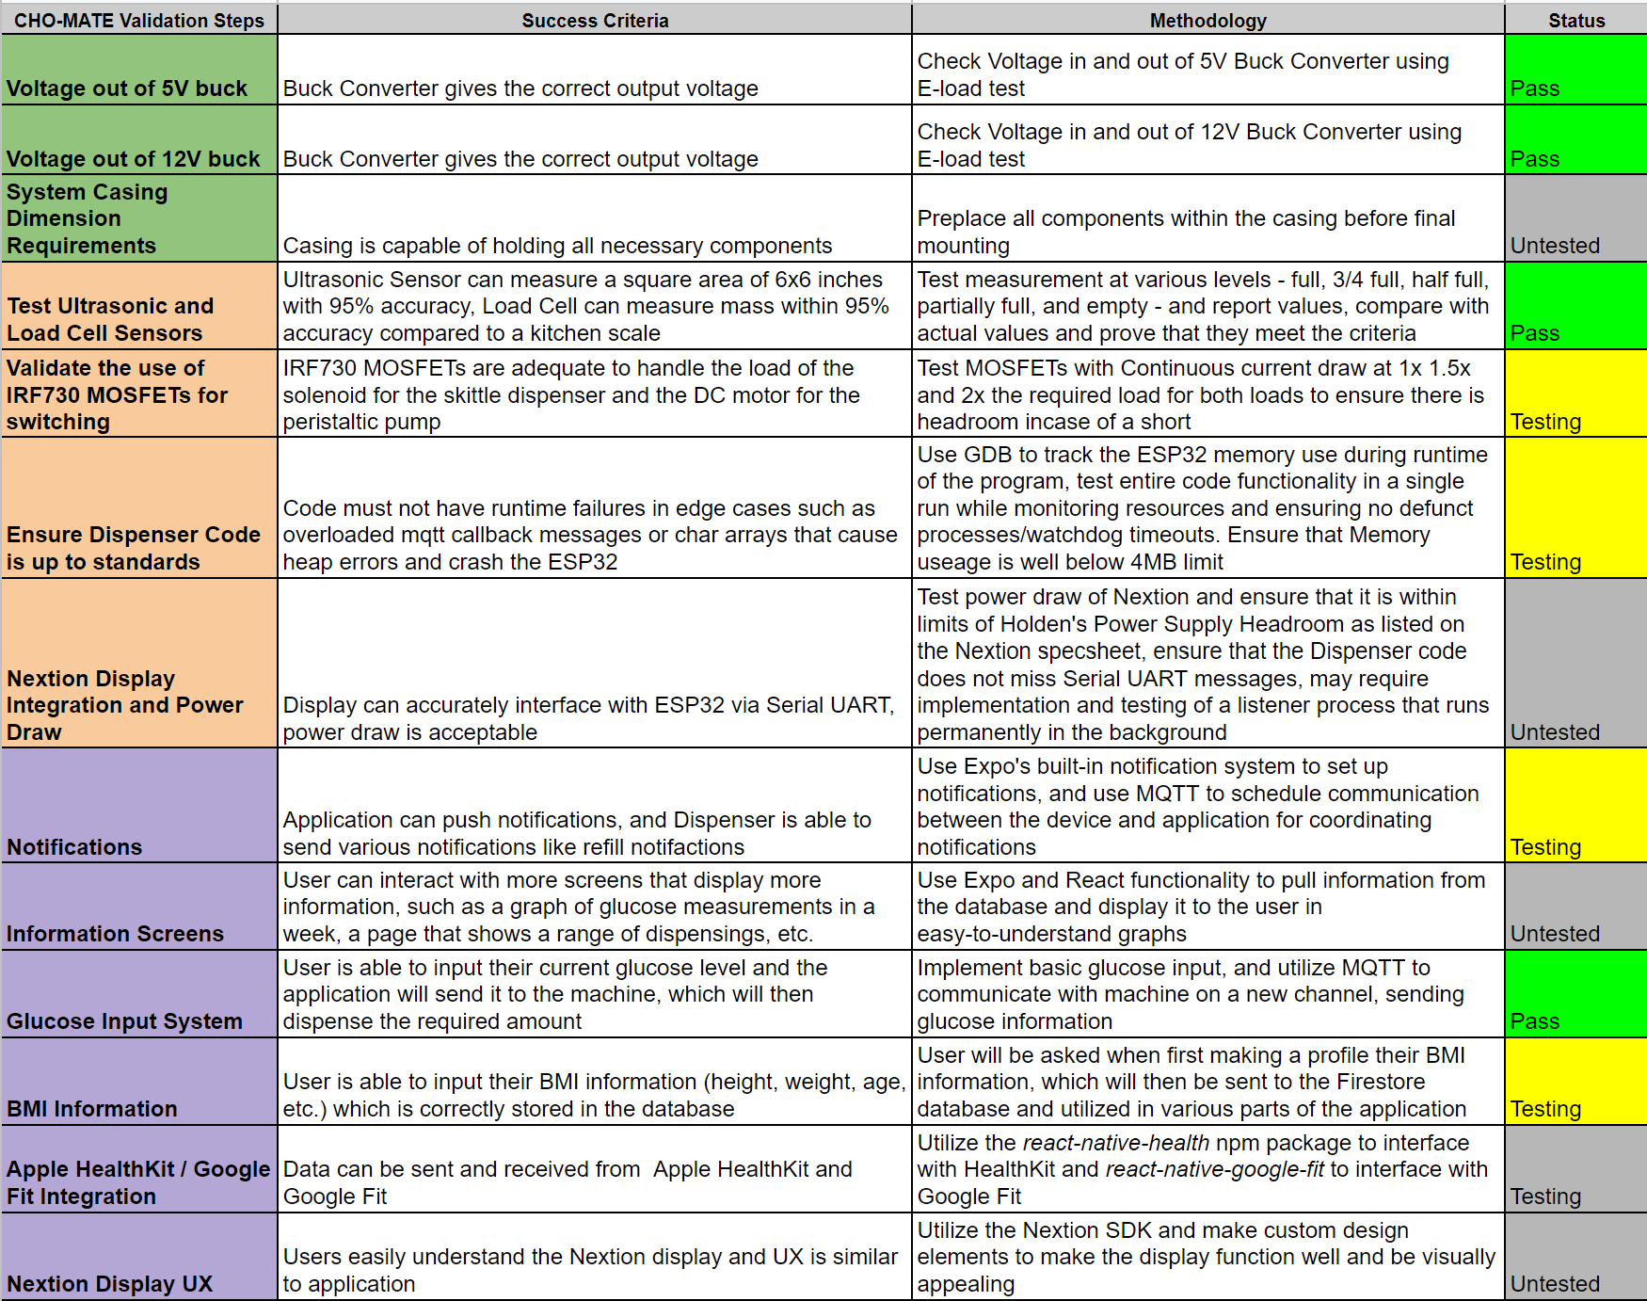
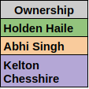
Validation Plan

Slide 14
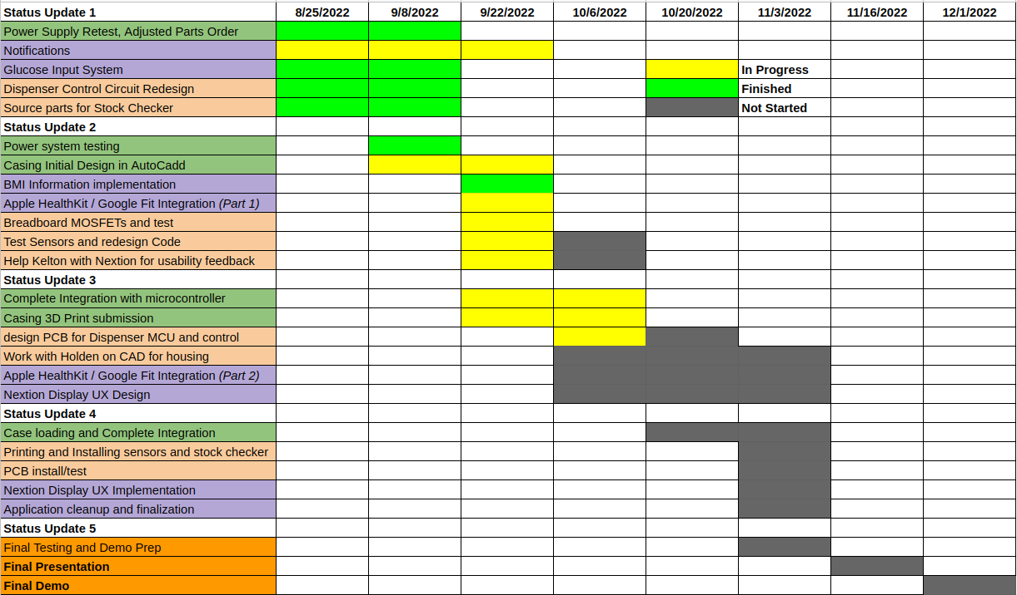
Execution Plan

Slide 15
Questions?

